Slide 1

503106
ADVANCED WEB PROGRAMMING
CHAPTER 8: REST APIs and JSON
LESSON 08– REST APIs and JSON

Slide 2
JavaScript Object Notation
JSON: Stands for JavaScript Object Notation
Created by Douglas Crockford
Defines a way of serializing JavaScript objects
to serialize: to turn an object into a string that can be deserialized
to deserialize: to turn a serialized string into an object

Slide 3
JSON.stringify()
We can use the JSON.stringify() function to seralize a JavaScript object:
const bear = { name: 'Ice Bear',
hobbies: ['knitting', 'cooking', 'dancing'] };
const serializedBear = JSON.stringify(bear);
console.log(serializedBear);
CodePen

Slide 4
JSON.parse()
We can use the JSON.parse() function to deseralize a JavaScript object:
const bearString = '{"name":"Ice Bear","hobbies":["knitting","cooking","dancing"]}';
const bear = JSON.parse(bearString);
console.log(bear);
CodePen

Slide 5
REST
REST stands for “representational state transfer,” and the grammatically troubling “RESTful” is used as an adjective to describe a web service that satisfies the principles of REST.
The formal description of REST is complicated, and steeped in computer science formality, but the basics are that REST is a stateless connection be‐ tween a client and a server. The formal definition of REST also specifies that the service can be cached and that services can be layered (that is, when you use a REST API, there may be other REST APIs beneath it).

Slide 6
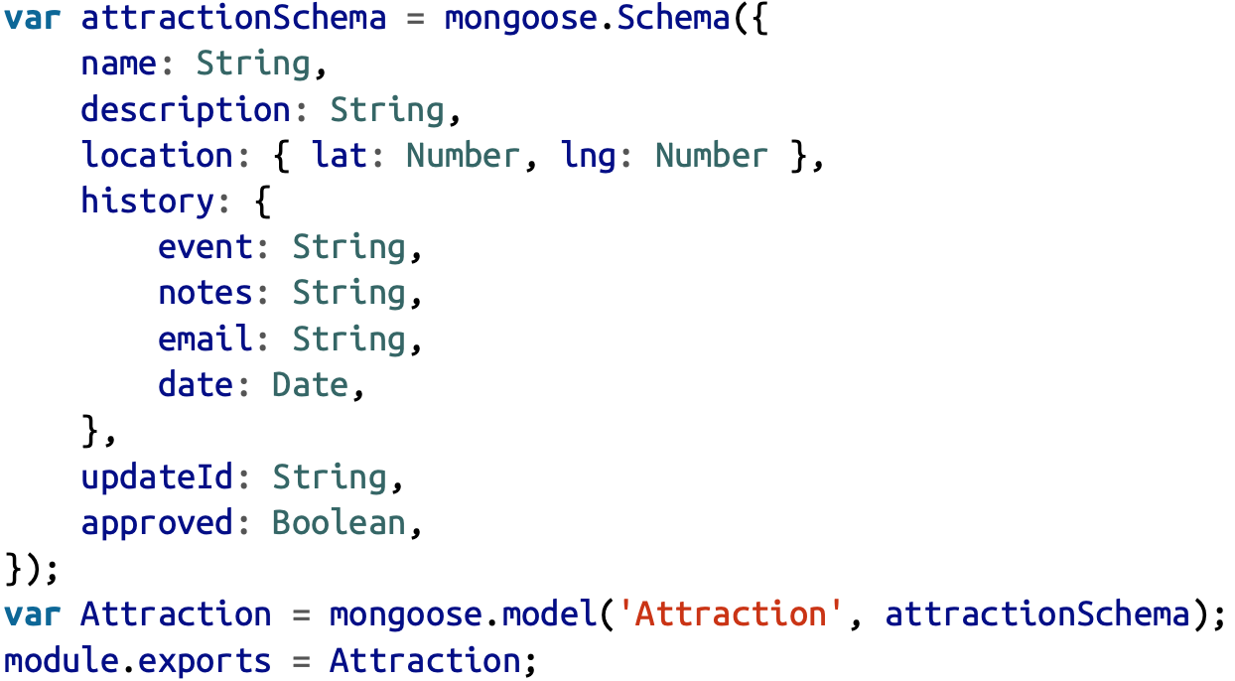
Create API
We’ll plan our API out before we start implementing it. We will want the following functionality:
GET /api/attractions
GET /api/attraction/:id
POST /api/attraction
PUT /api/attraction/:id
DEL /api/attraction/:id
Create the model

Slide 7
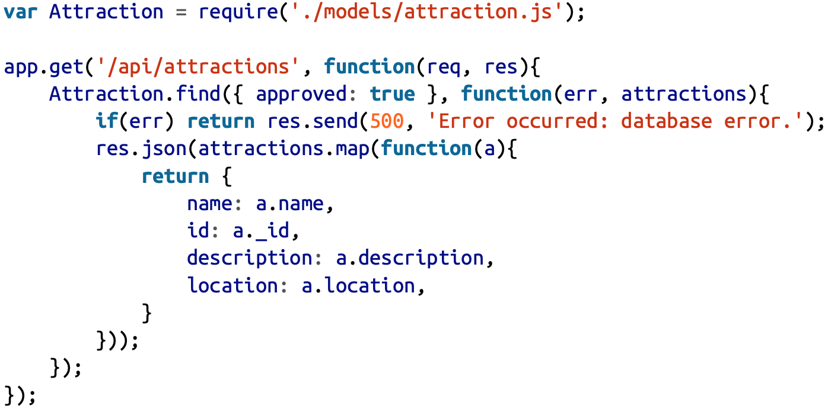
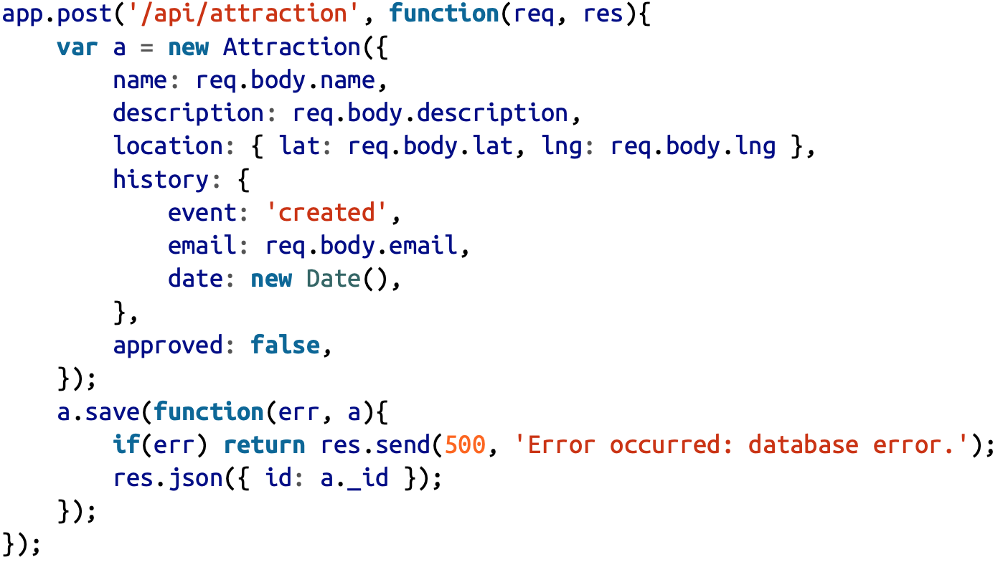
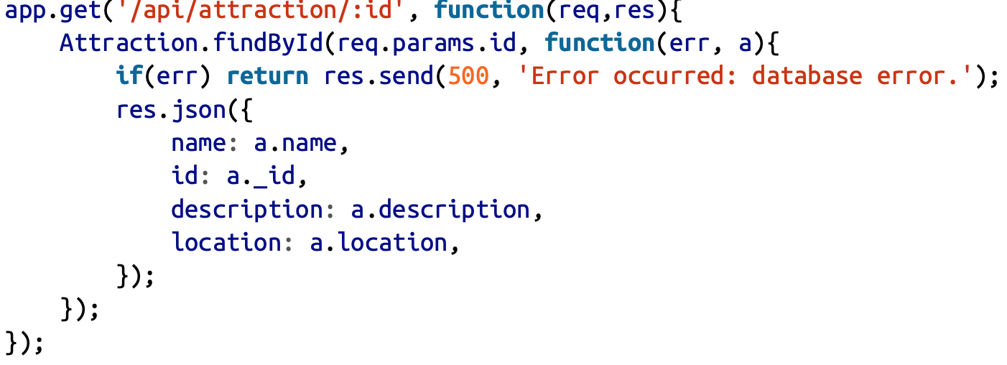
Using Express to Provide an API

Slide 8
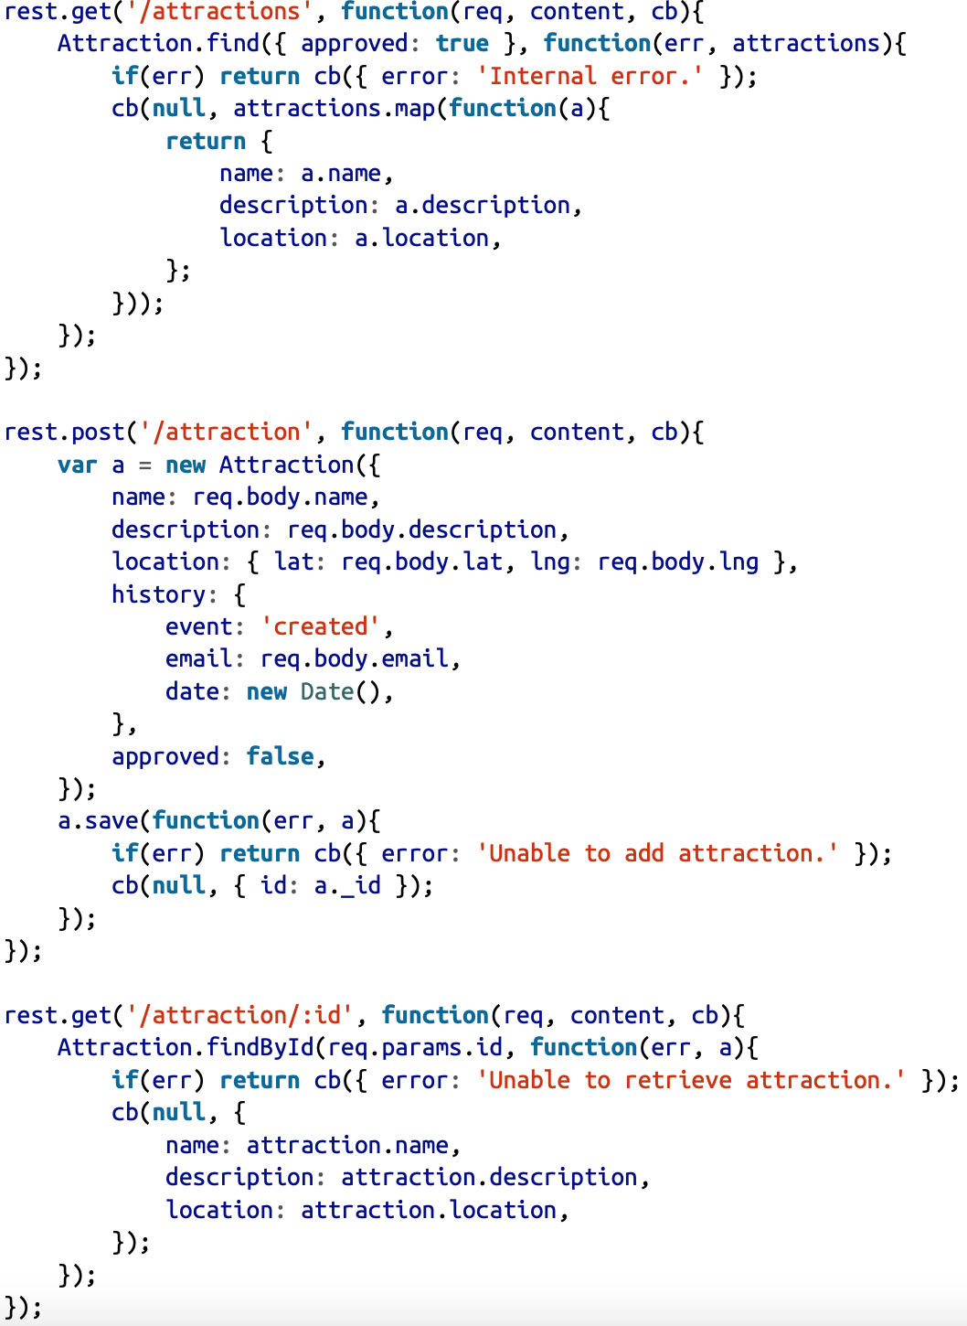
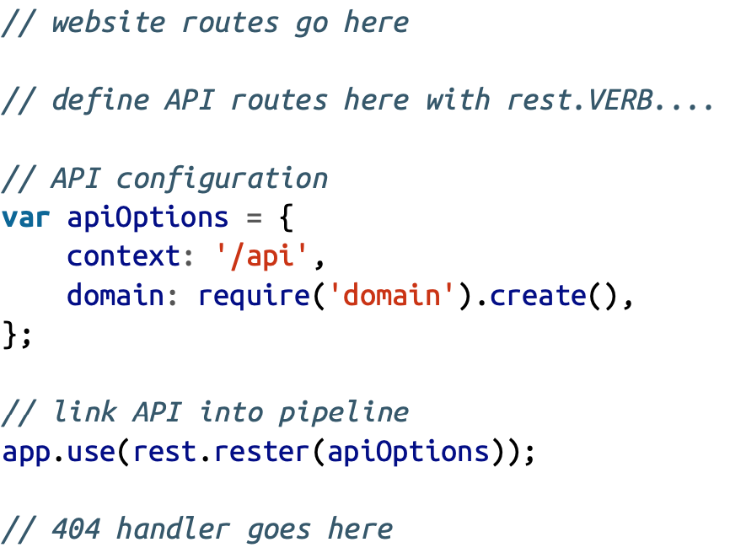
Using a REST Plugin
Install npm install --save connect-rest
Import: var rest = require('connect-rest');

Slide 9
Test API
You can test API by using other application like Postman, chrome extension

Slide 10
Cross-Origin Resource Sharing (CORS)
If you’re publishing an API, you’ll likely want to make the API available to others. This will result in a cross-site HTTP request. Cross-site HTTP requests have been the subject of many attacks and have therefore been restricted by the same-origin policy, which restricts where scripts can be loaded from.
CORS is implemented through the Access-Control-Allow-Origin header. The easiest way to implement it in an Express application is to use the cors package (npm install --save cors). To enable CORS for your application:
app.use(require('cors')()); or app.use('/api', require('cors')());

Slide 11
Exercise
Create API for student management
Create layout for student management and connect with API above

